Slide 1
Classroom Environment Controller (CEC)
CE211 – Circuit Analysis Project
Team Members:
Shayan Rizwan (2024585)
Syed Ali Hassan (2024616)
Hafiz Usman Abdullah (2024190)

Slide 2

Actual Hardware Circuit
In today’s technology-driven world, every modern engineering system — from home automation to industrial control — relies on circuits that sense, process, and respond intelligently to real world signals. Understanding and applying circuit analysis techniques is fundamental to the design of such systems.
Therefore, we decided to integrate three circuits into a singular circuit, and incorporate logic based outputs, simulating automation.

Slide 3
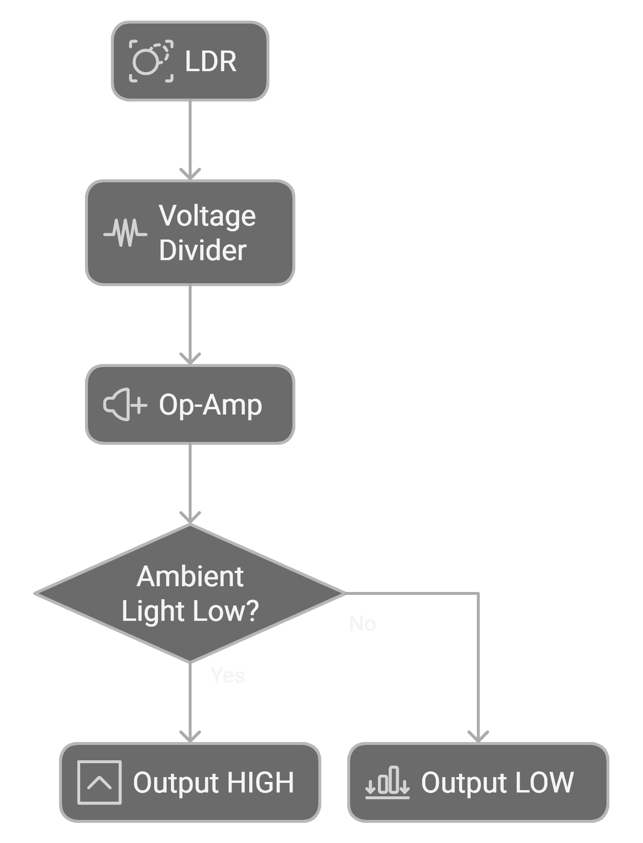
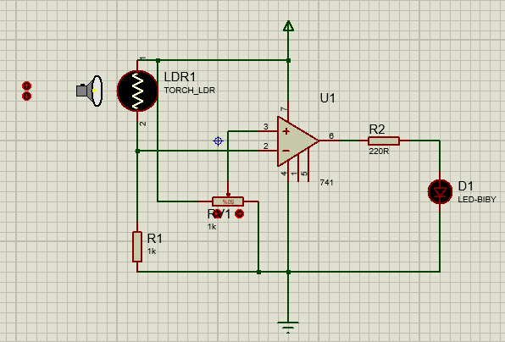


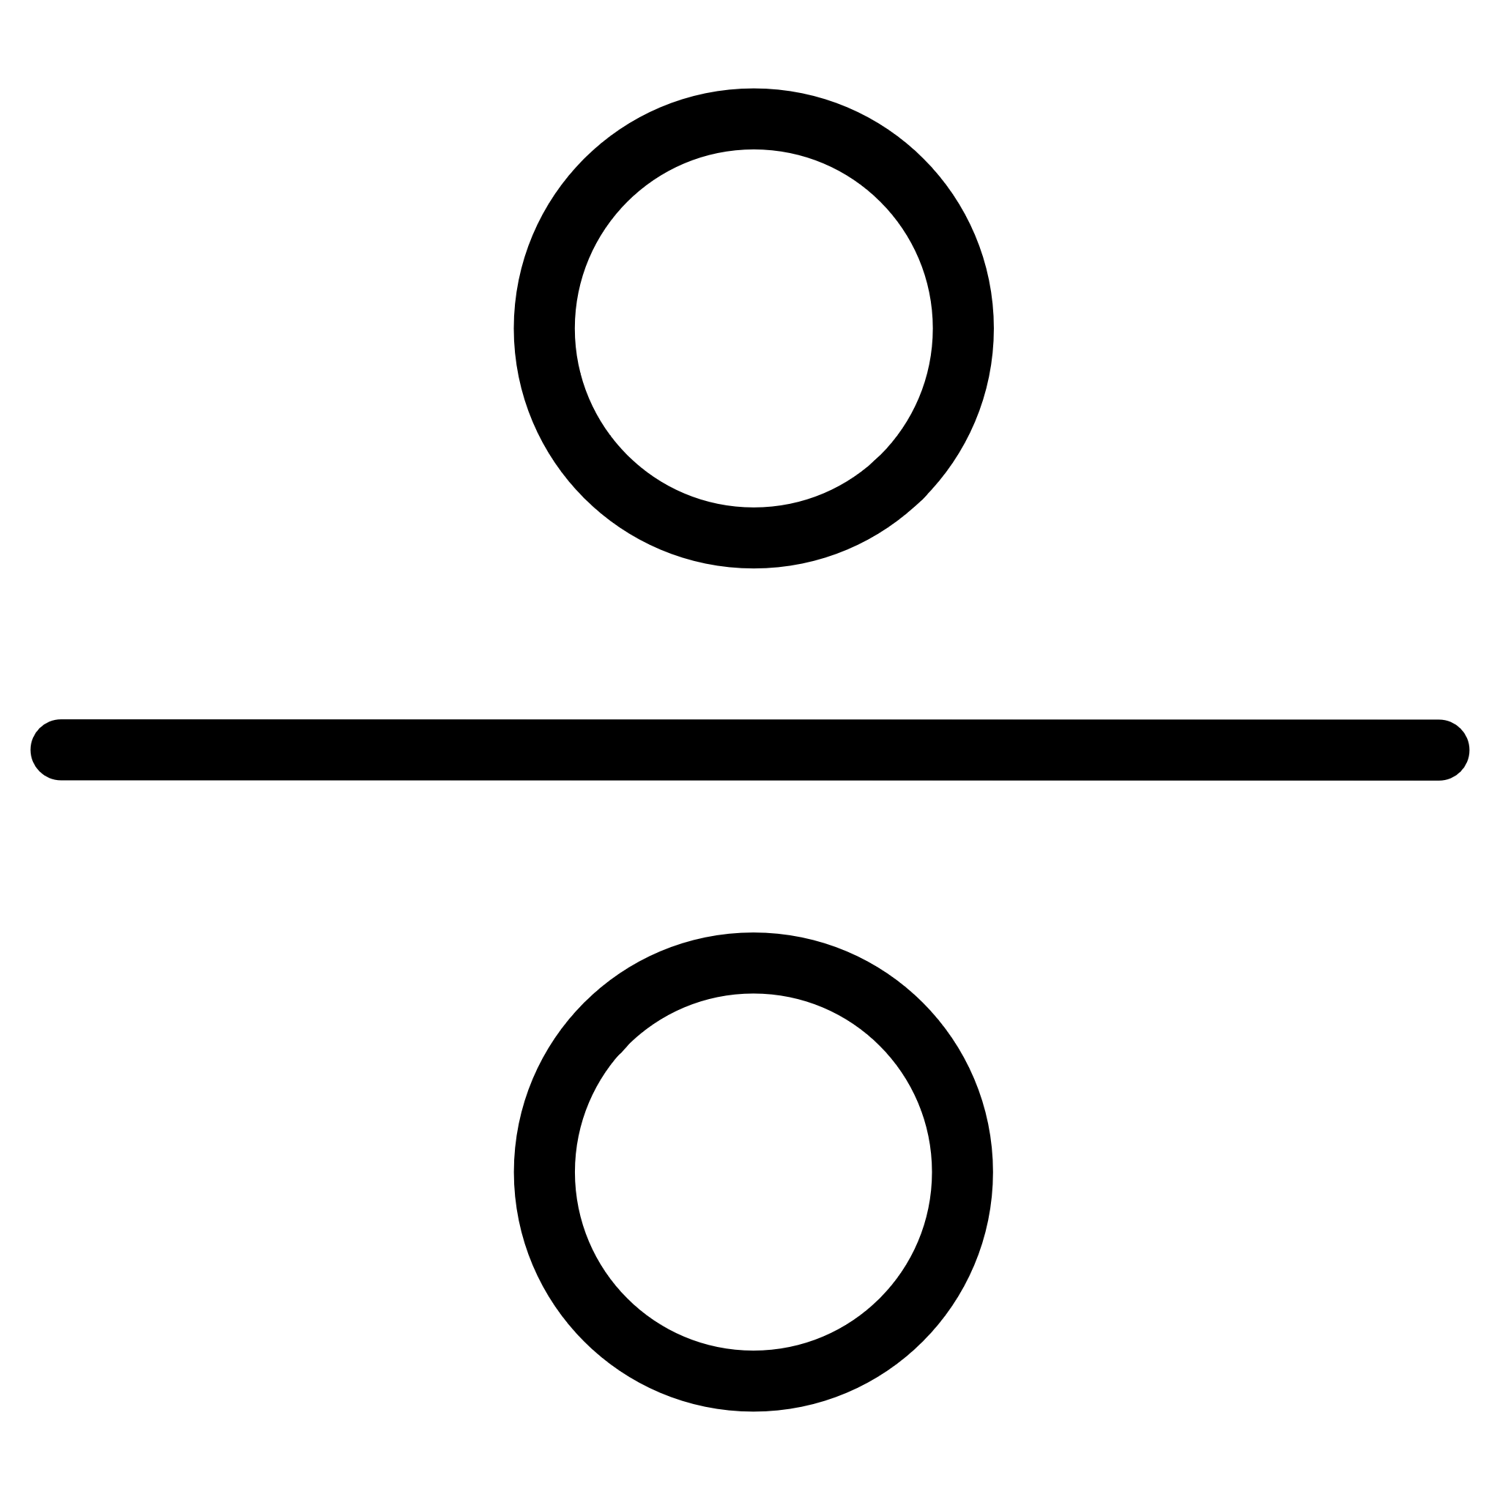

Automatic Lighting System
Concept & Circuit Operation
Uses an LDR-based light sensing circuit
Ambient light level converted into voltage using a voltage divider
An op-amp (LM324 / 741) is used as a comparator
Output becomes HIGH when ambient light is LOW
Demonstrates practical use of comparators, reference voltages, and thresholds

Slide 4
Automatic Lighting System
Components & CE211 Relevance
LDR
CE211 Link:
Potentiometer (threshold adjustment)
Voltage dividers
LM324 / 741 Op-Amp
Op-amp comparator behavior
LED + 220 Ω current-limiting resistor
Analog-to-digital signal interpretation
1 kΩ resistor

Slide 5
Presence Detection (IR Beam-Break System)
Concept & Logic Integration
Infrared (IR) sensor detects presence via beam interruption
Sensor output is inverted to achieve correct logic behavior
Inversion ensures output is HIGH when presence is detected
Output is logically combined with the LDR output using an AND gate
Logic condition: Light ON = Low Ambient Light AND Presence Detected

Slide 6
Presence Detection (IR Beam-Break System)
Components & CE211 Relevance
IR sensor module
CE211 Link:
Logic inverter (NOT gate)
Boolean logic implementation
AND gate
Logic gate truth tables
Indicator LED
Interfacing sensor outputs with digital logic

Slide 7
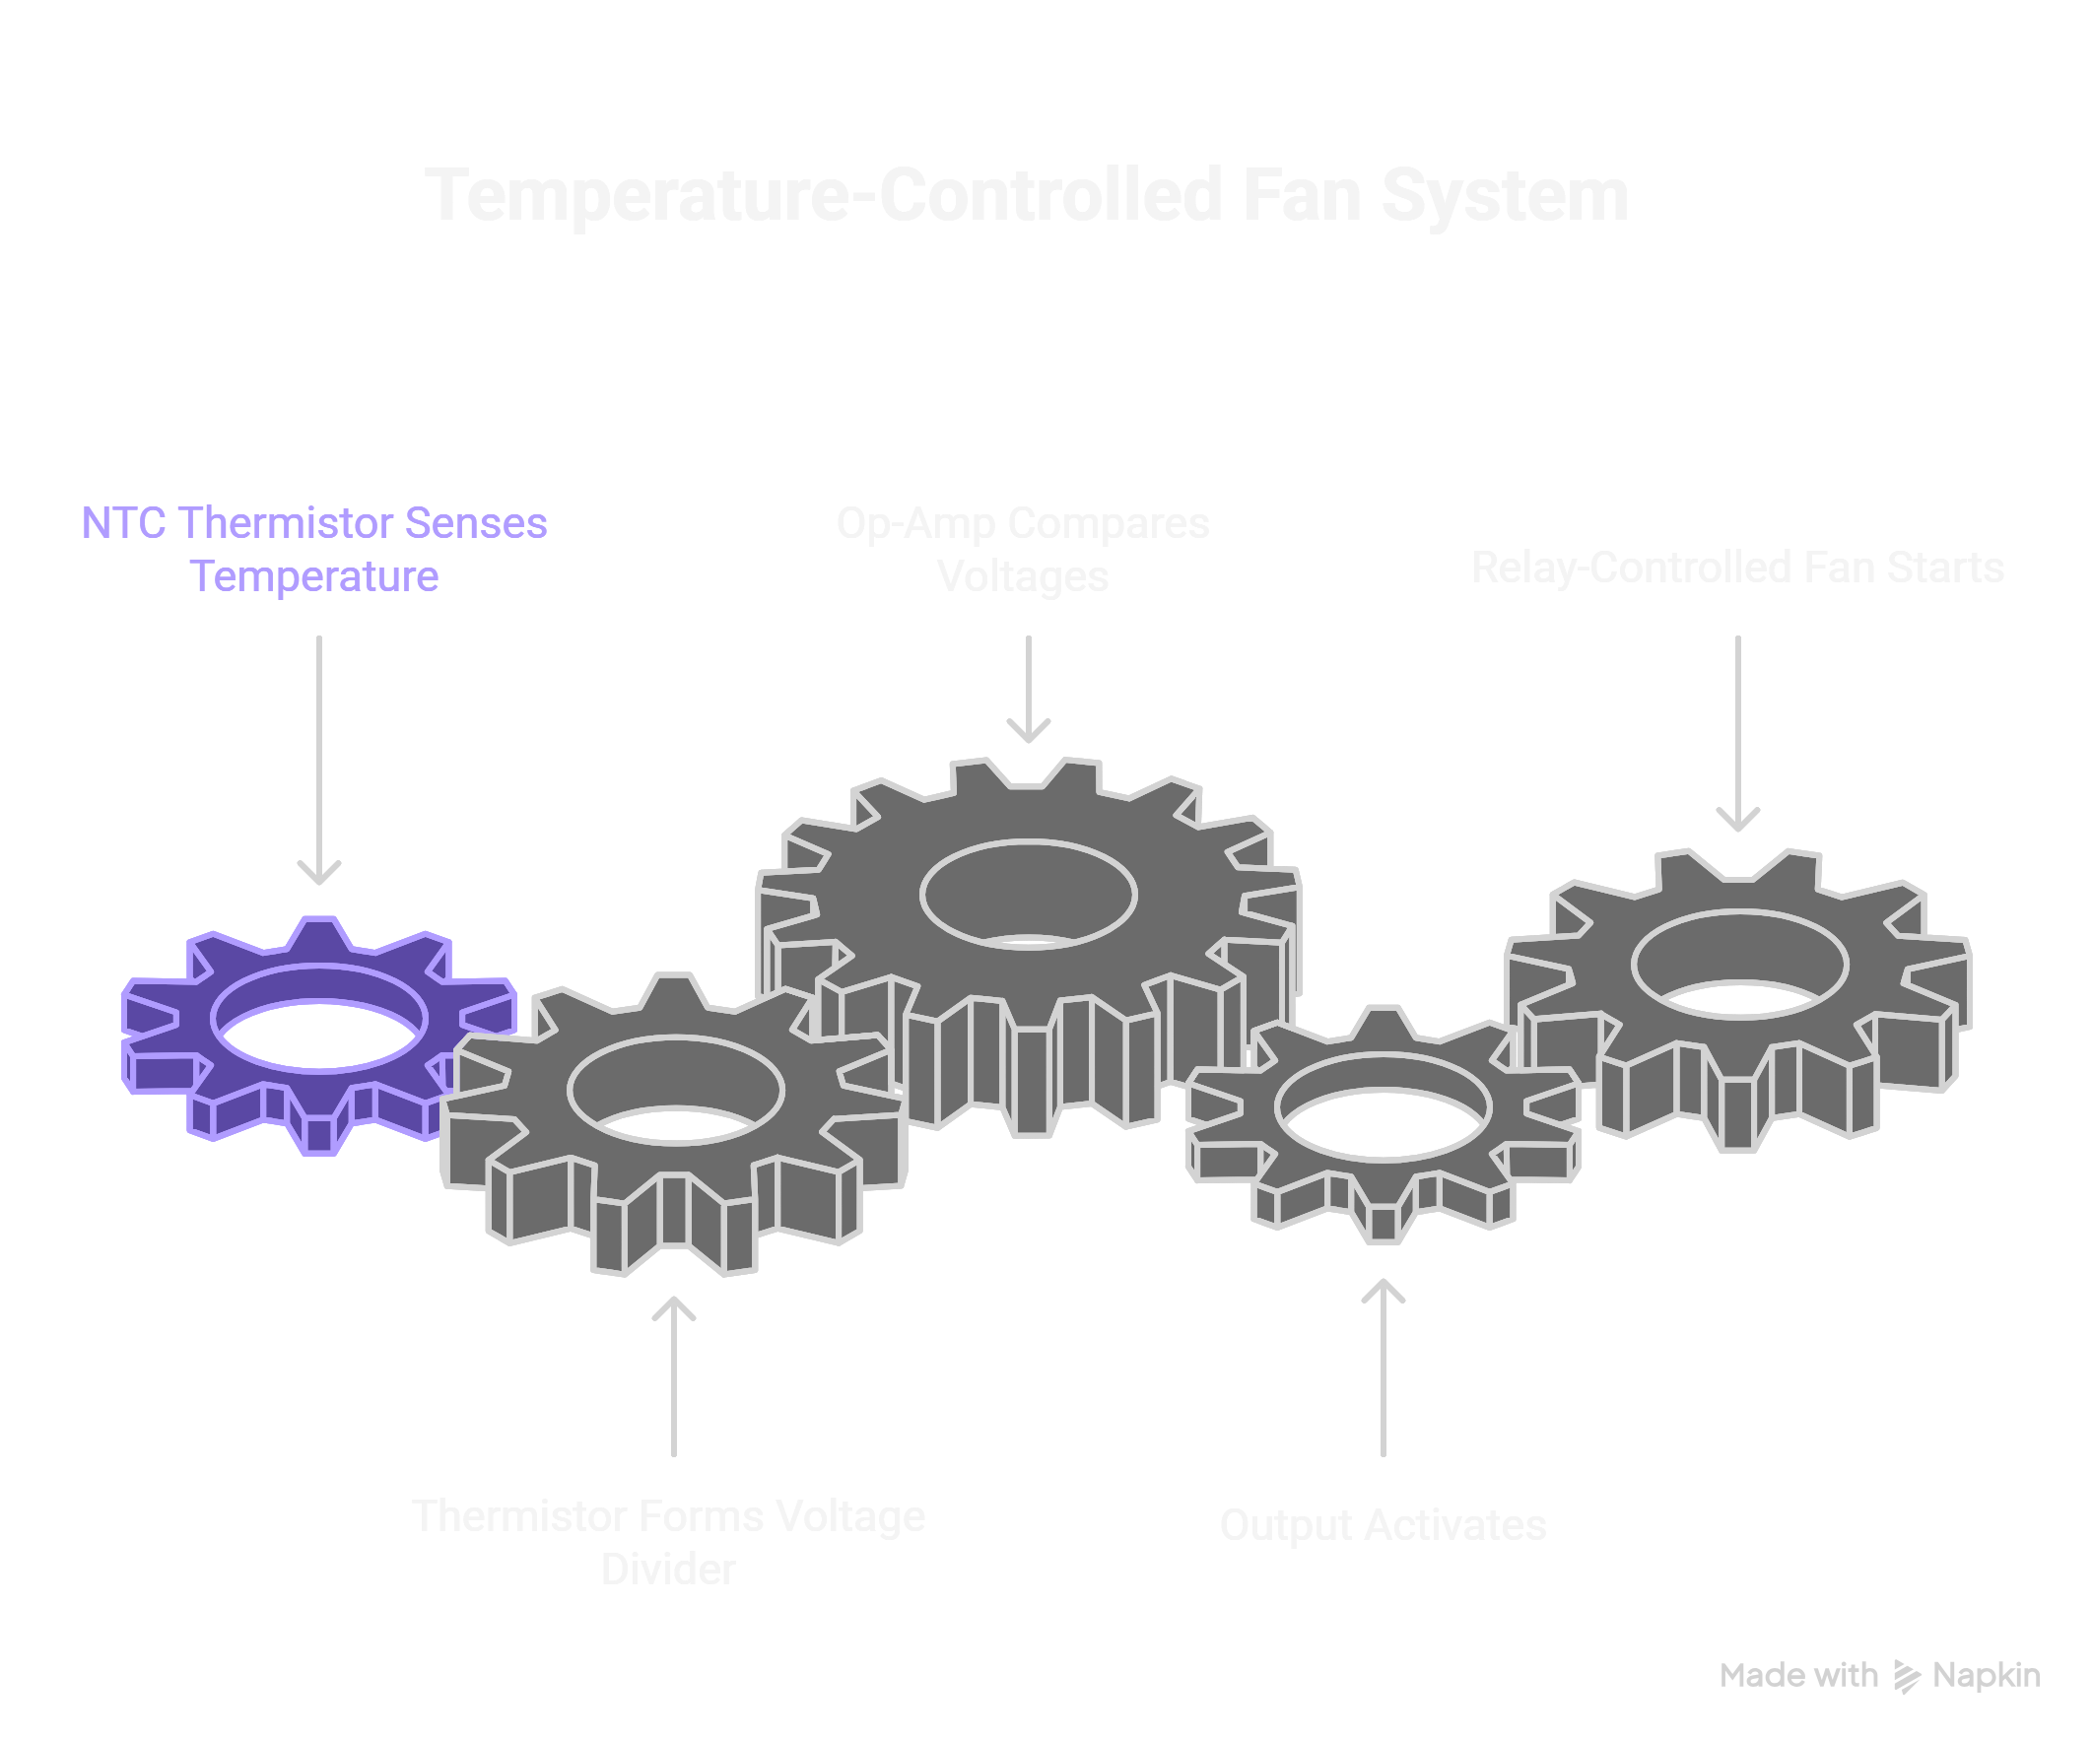
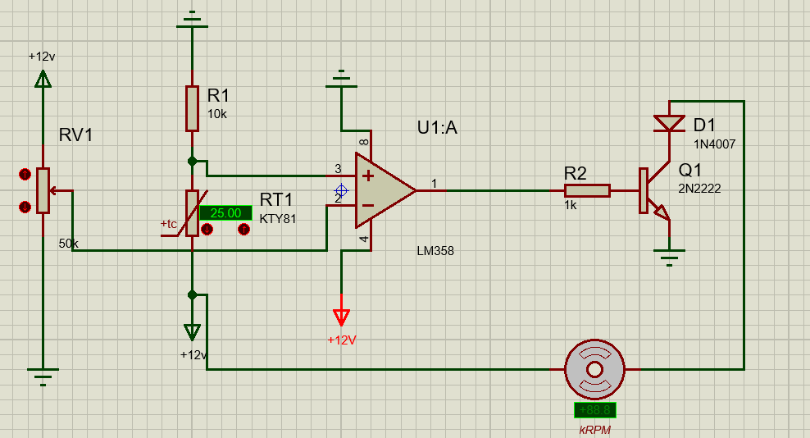
Temperature-Controlled Fan System
Concept & Working Principle
Uses an NTC thermistor to sense temperature
Thermistor forms a voltage divider
Op-amp compares sensed voltage with reference
When temperature rises above threshold → output activates
Output drives a relay-controlled 12 V DC fan

Slide 8
Temperature-Controlled Fan System
Components & CE211 Relevance
NTC Thermistor
CE211 Link:
LM324 Op-Amp
Voltage regulation
Potentiometer (temperature threshold control)
Transistor switching
NPN Bipolar Junction Transistor
12 V DC source
Diode
DC Fan

Slide 9

Hardware Demonstration
“Real-time demonstration of the Classroom Environment Controller”

